Slide 1
Online Course Marketplace
A Full-Stack E-Learning Platform with Shopping Cart
Presented by: Chanakshi Bedse
Enrollment Number: ADT23SOCB1517
Guide/Supervisor: Rohini Bhosale Mam
Department of Information Technology
Date: 07/11/2025

Slide 2
Project Overview and Introduction
Introduction:
The Online Course Marketplace is a full-stack web application that enables users to browse, search, and purchase online courses across multiple categories. The platform features a modern e-commerce interface with shopping cart functionality, user authentication, and secure payment processing, designed to make quality education accessible and easy to acquire.
Problem Statement:
Learners today face challenges in finding and purchasing quality online courses due to:
Scattered course offerings across multiple platforms
Complex purchasing processes
Lack of intuitive search and filtering mechanisms
Unclear course information and pricing This project addresses these issues by creating a centralized, user-friendly marketplace.

Slide 3
Scope and Objectives:
Project Scope
In Scope:
User registration and authentication system
Course browsing with search and category filters
Detailed course information pages
Shopping cart functionality (add, remove, update)
Secure checkout and payment processing
Out of Scope:
Course content delivery (video streaming)
Live class functionality
Instructor course creation portal
Discussion forums and Q&A
Mobile native applications
Multi-language support

Slide 4
Key Objectives
Develop Responsive User Interface
Modern, clean design following current UI trends
Mobile-first approach
Cross-browser compatibility
Smooth animations and transitions
Implement Shopping Cart Functionality
Add/remove courses from cart
Cart persistence using localStorage
Real-time cart count updates
Dynamic price calculations
Create Intuitive Navigation System
Easy course discovery with search
Category-based filtering
Clear visual hierarchy
Accessible design patterns

Slide 5
Technology Stack
Frontend Technologies
HTML5 - Semantic markup structure
CSS3 - Modern styling with Flexbox/Grid
  Custom CSS with gradient backgrounds
  Responsive media queries
  Hover effects and transitions
JavaScript (ES6+) - Dynamic interactions
  DOM manipulation
  Event handling
  Cart logic implementation
Responsive Design Techniques
  Mobile-first approach
  Flexible layouts
  Adaptive images

Slide 6
Implementation and Results (Frontend - UI/UX)
Homepage Design
Hero Section:
Background: Beautiful purple gradient (#9b7fbf to #8b6fb0)
Headline: "Learn the World's Best Skills Online" (Large, bold, dark gray)
Subheading: "Expert-led courses from top universities and companies. Start your journey today."
CTA Button: Bright blue "Explore All Courses" button with hover effect
Layout: Centered content with ample padding
Featured Courses:
Section Title: "Our Featured Courses" (centered, bold)
Card Layout: Horizontal display of 2-3 course cards
Visual Design: Color-coded cards (Blue, Green, Yellow)
Minimalist: Clean design showing course titles on colored backgrounds

Slide 7
Implementation (Frontend - Course Catalog)
Course Catalog Page
Header Section:
Page Title: "Explore Our Full Catalog"
Search Bar: White background with "Search courses..." placeholder
Category Filter: Dropdown with "All Categories" default option
Course Grid:
Card Design: White cards with colored thumbnails
Spacing: Consistent gap between cards
Course Card Components:
Thumbnail: Large colored section with course type text
Price: Prominent INR pricing (₹2,499 - ₹3,999)
CTA Button: Blue "Add to Cart" button

Slide 8
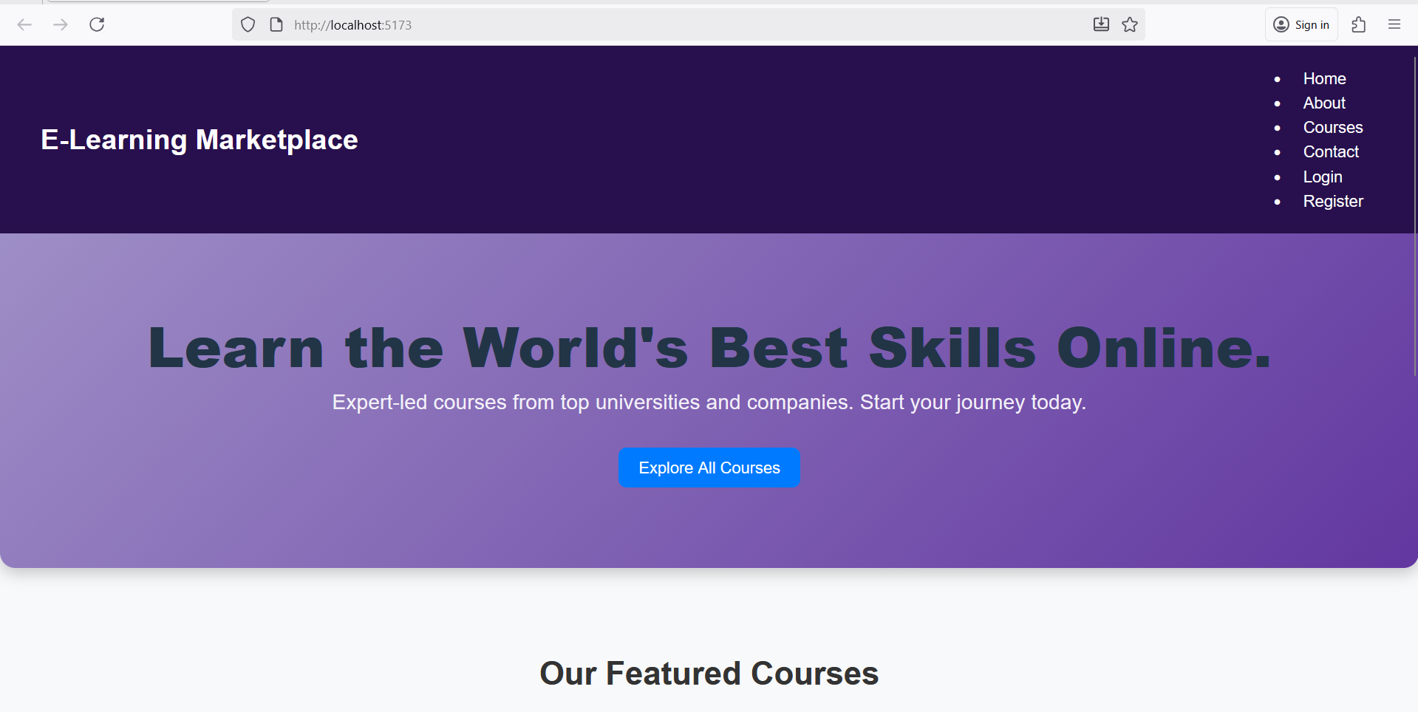

Slide 9
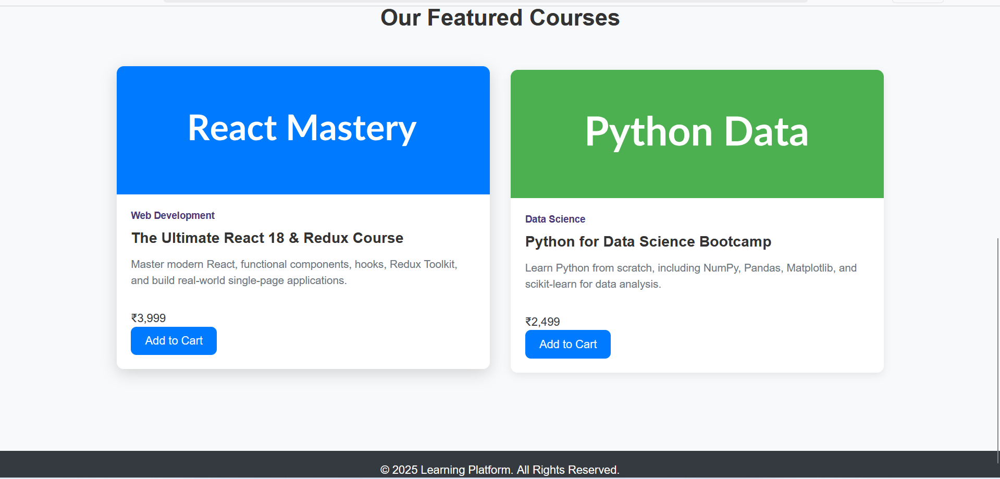

Slide 10
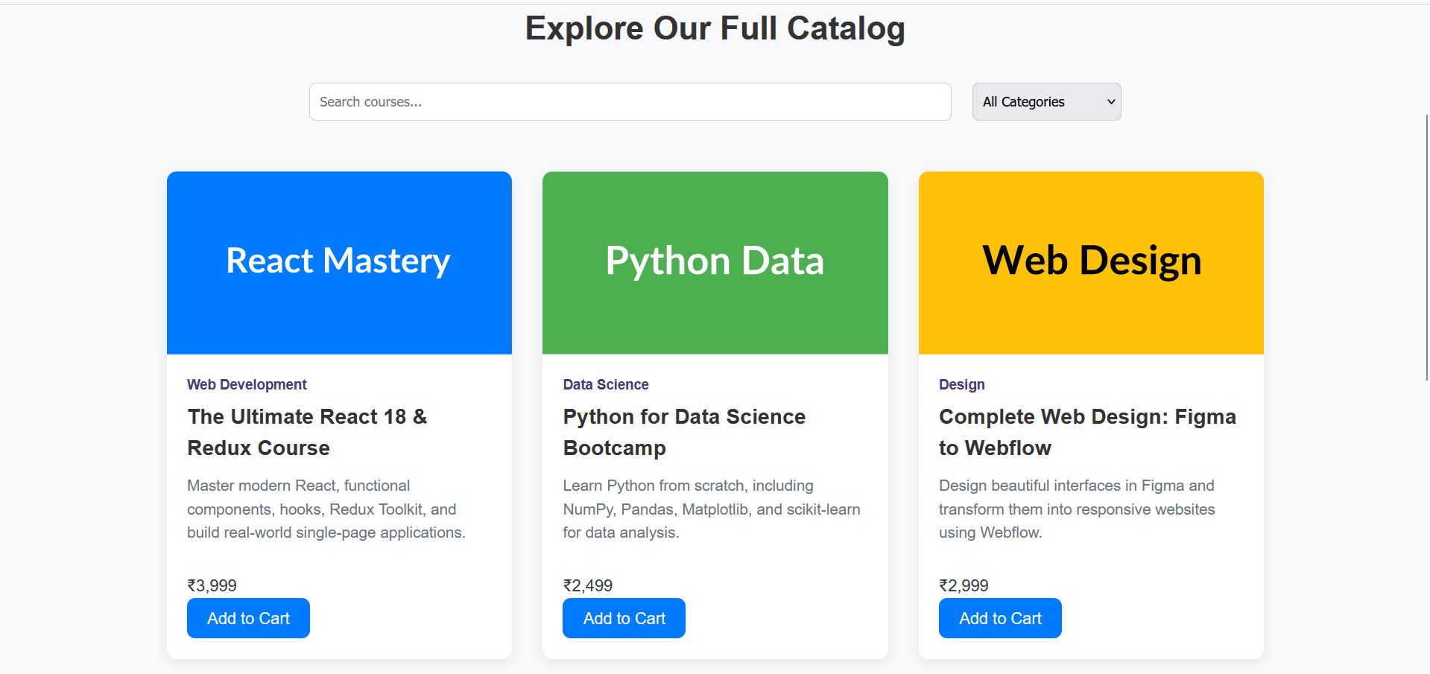

Slide 11
Conclusion and Future Scope
Project Achievements: ✓ Successfully developed a responsive e-learning marketplace frontend ✓ Created modern, intuitive user interface with gradient backgrounds ✓ Implemented fully functional shopping cart with localStorage
Objectives Met:
✅ Responsive UI adapting to desktop, tablet, and mobile.
✅ Shopping cart functionality with add/remove operations.
✅ Intuitive navigation with search and filters.
✅ Optimal performance with fast load times.
The project successfully demonstrates a complete frontend implementation for an e-learning marketplace, providing users with an engaging and seamless course browsing and selection experience.

